Slide 1
INTRODUCTION TO COLLECTION

Slide 2
Objectives
What is Collection?
Collections Framework
Collections Hierarchy
Collections Implementations
Note: You will be learning more about collections and generics in Iteration 1. This module is an introduction and overview to collections at preliminary stage.

Slide 3
Collection Framework
Collections Framework is a unified architecture for managing collections.
The main parts of a Collections Framework are:
Interfaces:
Core interfaces defining common functionality exhibited by collections.
Implementations:
Concrete classes of the core interfaces providing data structures.
Operations:
Methods that perform various operations on collections.
Notes:
The Collections Framework in .NET (System.Collections namespace) gives you several classes to satisfy most of your coding needs. They've been tried, tested and tweaked. Pick the best one for your job and you'll get - at the lest - reasonably good performance. And when you need something a little more custom, the System.Collections namespace is loaded with interfaces and utilities:
Interfaces:
Interfaces allow collections to be manipulated independently of the details of their representation. In object-oriented languages, these interfaces generally form a hierarchy.
Implementation:
In essence, these are reusable data structures.
Operations:
These algorithms are said to be polymorphic because the same method can be used on many different implementations of the appropriate collections interface. In essence, algorithms are reusable functionality.

Slide 4
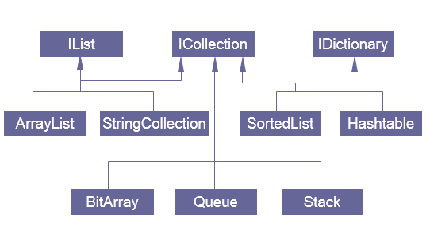
Collections Hierarchy

Slide 5
System.Collections: Interfaces
Core Interface | Description
ICollection | Defines size, enumerators and synchronization methods for all collections.
IComparer | Exposes a method that compares two objects.
IDictionary | Represents a collection of key-and-value pairs.
IDictionaryEnumerator | Enumerates the elements of a dictionary.
IEnumerable | Exposes the enumerator, which supports a simple iteration over a collection.
IEnumerator | Supports a simple iteration over a collection.
IHashCodeProvider | Supplies a hash code for an object, using a custom hash function.
IList | Represents a collection of objects that can be individually accessed by index.
Notes:
The table shows the Interfaces available in the System.Collections namespaces. These interfaces are implemented by various collection classes which we will see in a diagram a little later.

Slide 6
System.Collections: Implementations
ICollection | IList | IDictionary
BitArray | ArrayList | Hashtable
Stack | StringCollection | SortedList
 | Queue
Notes:
This table shows some of the basic and frequently used collection classes which implements the Collection Interfaces.

Slide 7
System.Collections: Operations
Basic collection operations:
Check if an object exists in collection.
Retrieve an object from collection.
Add an object to collection.
Remove an object from collection.
Iterate collection and inspect each object.
Each operation has a corresponding method implementation for each collection type.

Slide 8
Collections Characteristics
Ordered:
Elements are stored and accessed in a specific order.
Sorted:
Elements are stored and accessed in a sorted order.
Indexed:
Elements can be accessed using an index.
Unique:
Collection does not allow duplicates.

Slide 9
Collection Implementations
List: Lists of things (classes that implement IList)
Map: Things with a unique id (classes that implement IDictionary)
Custom Collections (will be discussed later)

Slide 10
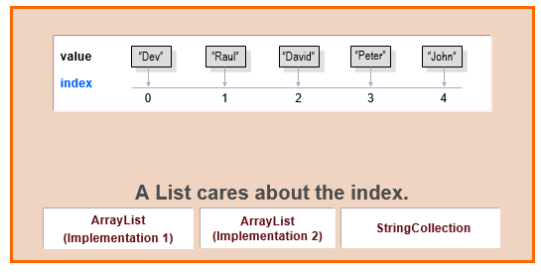
List
Notes:
A list cares about the index. The one thing that List has that non-lists don’t have is a set of methods related to the index. All List implementations are ordered by index position – a position that you determine either by setting an object at a specific index or by adding it without specifying position, in which case the object is added to the end.

Slide 11
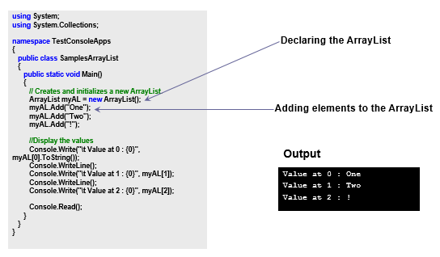
List Implementations: ArrayList (Implementation 1)
Notes:
A straightforward way of accessing values in an ArrayList.

Slide 12
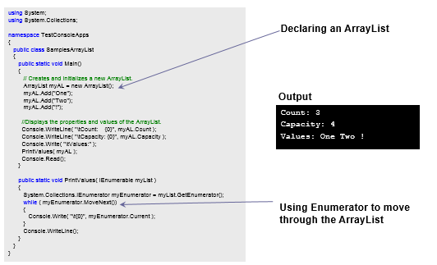
List Implementations: ArrayList (Implementation 2)
Notes:
ArrayList – A second way of accessing the elements in the ArrayList.

Slide 13
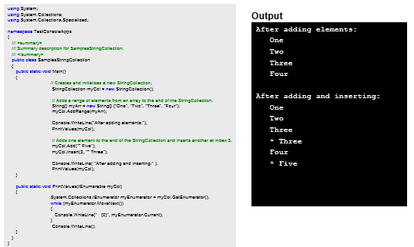
List Implementations: StringCollection
Notes:
The code shows how to add, insert, and access elements to/from a StringCollection.
See inline comments for step wise explanation.

Slide 14
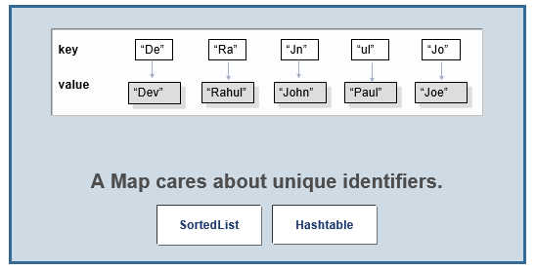
Map
Notes:
A Map cares about unique identifiers. You map a unique key (the ID) to a specific value, where both the key and the values are of course objects. You’re probably quite familiar with Maps since many languages support data structures that use key/value or name/value pair. The Map implementations let you do things like search for a value based on the key, as for a collection of just the values, or ask for a collection of just the keys.

Slide 15
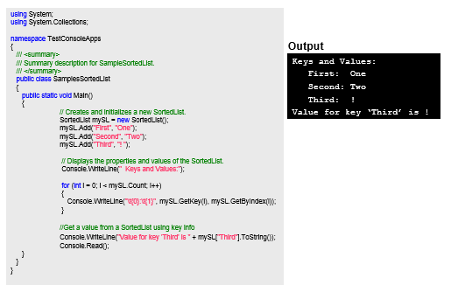
Map Implementations: SortedList
Notes:
This code shows how to add elements to a SortedList.
It also shows one of the ways in which these elements can be accessed.
It also shows how to access a value from a SortedList using its key information.

Slide 16
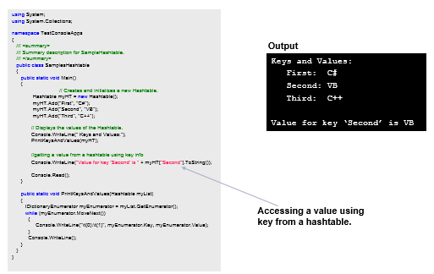
Map Implementations: Hashtable

Slide 17
Reference
For further details on collections please refer this link
http://www.tutorialspoint.com/csharp/csharp_collections.htm
http://www.codeproject.com/Articles/31640/Basics-of-NET-Collections-in-C
http://msdn.microsoft.com/en-us/library/ybcx56wz.aspx
Notes:
Reference

